Slide 1
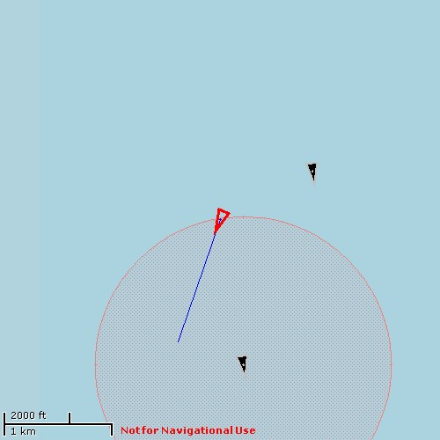
ADAC Year 6 Annual Meeting
ADAC Project Brief
“Arctic Vessel Monitoring Geofencing/Alert Awareness”
Buddy Custard, Capt, USCG (Ret.)
Dr. Shawn Butler
May 9, 2020

Slide 2
Project Team
ADAC Program Year 6 Annual Meeting 14 May 2020
Principal Investigators
Buddy Custard, Alaska Maritime Prevention & Response Network
Dr. Shawn Butler, University of Alaska Anchorage
Supporting Team:
Ed Page, Capt, USCG (Ret.), Marine Exchange of Alaska
Aaron Poe, Aleutian and Bering Sea Islands Land Conservation Council
Student Participation: Max Zaki
Project Champion: Hank Blaney, USCG HQ CG-255
Project Advocates: Kristin Mabry, NOAA; Joel Garlich-Miller, USFWS; Dr. Lori Polasek, ADF&G; Dr. Lauren Divine (Aleut Community of St. Paul)

Slide 3
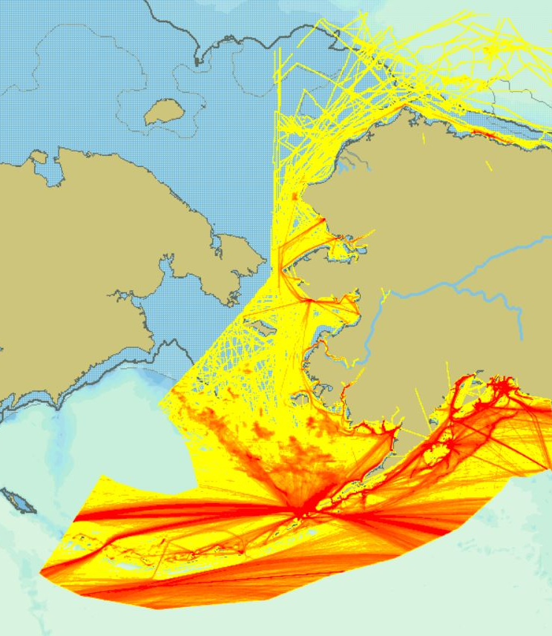
Problem Statement
ADAC Program Year 6 Annual Meeting 14 May 2020
~10,000 vessel transits annually in the U.S. Arctic region.
On any given day, 100 to 500 vessels operating within the U.S. Arctic region depending on the season.
The sheer volume in the number of vessels to keep continuous situational awareness in detecting vessel movement anomalies that could cause harm to people, property, and the marine ecosystem in this U.S. strategic region is overwhelming.
Coast Guard Arctic regional command centers are simultaneously managing multiple cases ranging from search and rescue, maritime law enforcement, homeland security, oil spill response and salvage, waterways management, and fisheries enforcement, as well as its other mandated missions throughout the other portions of the Western Alaska Captain of the Port Zone.
The enormous challenge of trying to manage this volume of information requires enhanced tools that to help sift through the hundreds of vessel movements during any given hour to detect a potential incident.

Slide 4
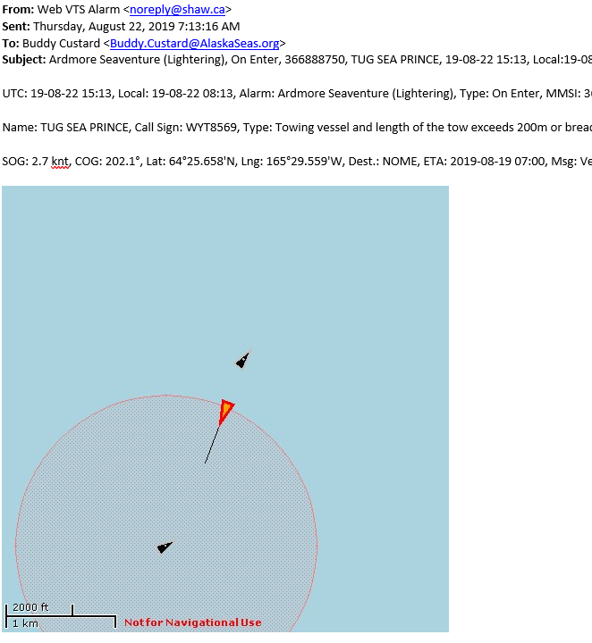
ADAC Program Year 6 Annual Meeting 14 May 2020
Project Description
Advance Arctic Maritime Domain Awareness & Management by capitalizing and enhancing Automatic Identification System (AIS) geofencing and alert notification technology, integrating into the unclassified PACTRACS system used by USCG District Seventeen.

Slide 5
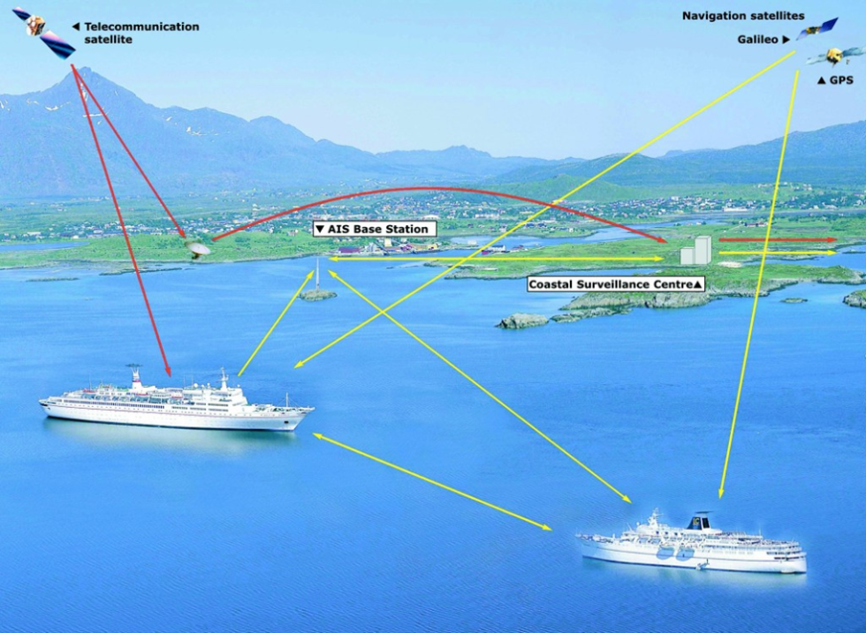
ADAC Program Year 6 Annual Meeting 14 May 2020
Baseline
AIS is an internationally adopted tracking system required by most commercial vessels to aid maritime safety, security, and environmental protection.
Vessels equipped with AIS transponders transmit position reports, speed, type of vessel, size, cargo, navigation status, and destination several times a minute.

Slide 6

ADAC Program Year 6 Annual Meeting 14 May 2020
AIS Geofencing Overview
AIS Animation

Slide 7
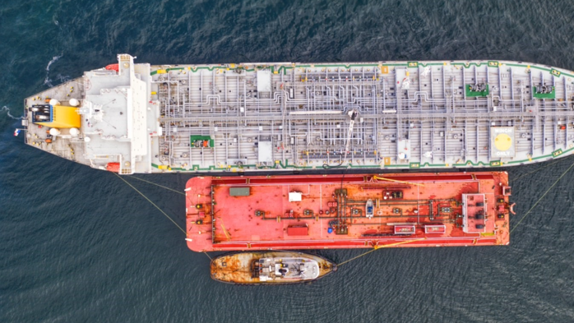
ADAC Program Year 6 Annual Meeting 14 May 2020
Relevance
Enhanced AIS capabilities enable decisionmakers from the Coast Guard, other agencies, and Arctic stakeholders to assess, monitor, and act as needed to reduce adverse impacts presented by maritime activity in Arctic waters

Slide 8
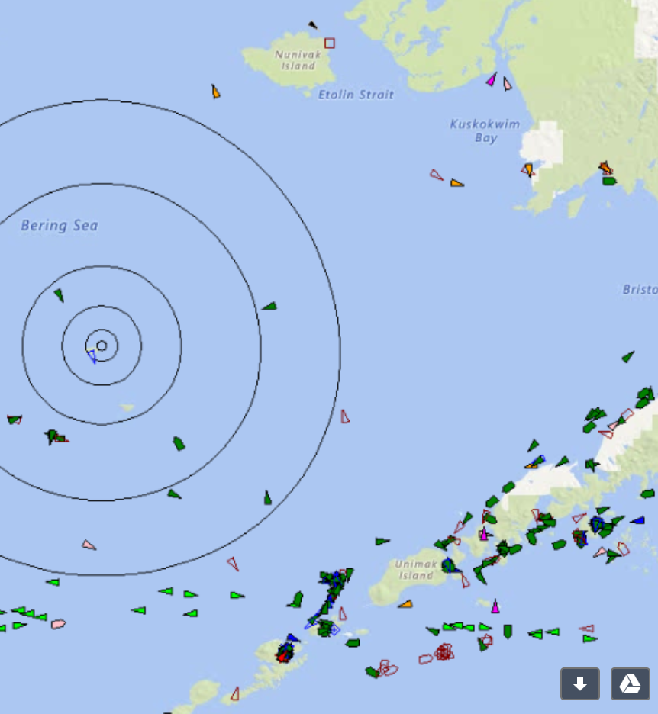
ADAC Program Year 6 Annual Meeting 14 May 2020
Project Objectives
Geofences / alerts can be customized by the end-user to meet agency requirements within PACTRACS.
Geofencing/alert files can be shared among users of vessel tracking display systems.
Geofences can have multiple filters and GIS overlays to better discriminate vessel type and activities.
Geofence can be developed around moving vessels
Alerts and notifications with visual reference points can be received on multiple unclassified platform devices by government agencies and vetted stakeholders.
Geofence/alert notifications sent to Social Media/email platforms for other Federal/State agencies and Arctic stakeholders.
Coastal Communities can receive tailored notification and alerts.

Slide 9
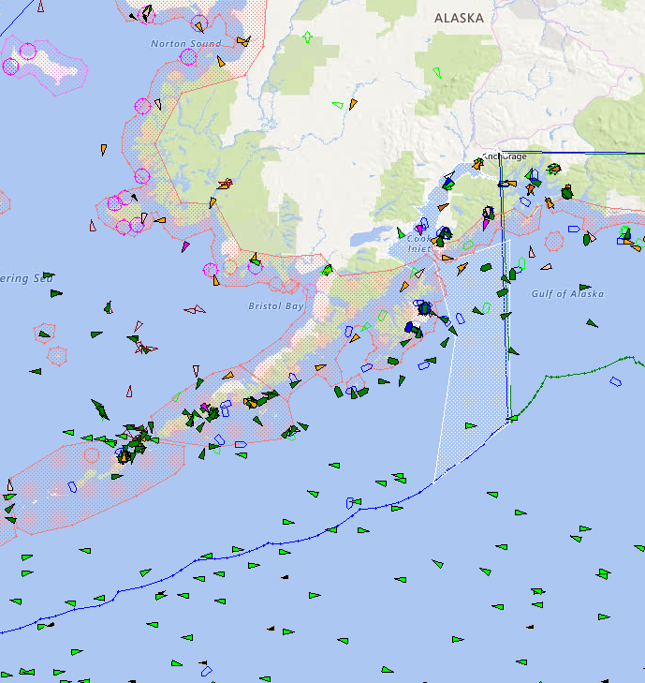
Planned Outcomes
ADAC Program Year 6 Annual Meeting 14 May 2020
Geofencing capabilities developed to meet USCG and other stakeholders needs, particularly dynamic zones
Web accessible tool to request AIS generated alerts or reports for USCG units, agencies and other authorized stakeholders
Delivery of requested alerts or information via e-mail, text messages or other identified means.
Enable USCG, resource trustees, other agencies and maritime stakeholders use of AIS to enhance safe, secure and environmentally sound maritime operations in the Arctic.

Slide 10

ADAC Program Year 6 Annual Meeting 14 May 2020
Key Milestones
July 2018
June 2020
Identify vessel alerting and management workflow process [Completed]
Identify customer and stakeholder requirements [Completed]
Develop Geofencing & Alert AIS software modifications [Completed]
Develop web-base geofence / alert request portal [Completed]
Test notification and alerts with agencies and relevant stakeholders [Completed]
Finalize software and complete transition plan [Completed]
Submit final project report [June 2020]

Slide 11
ADAC Program Year 6 Annual Meeting 14 May 2020
Established advisory committee to provide project requirements and oversight, providing several updates
Validated end-user geofencing and alert requirements through stakeholder engagements
  Provided project presentation at the: Alaska Tribal Conference on Environment Management, the Indigenous People’s Council for Marine Mammals, the Alaska Marine Science Symposium, the Alaska Forum on the Environment, Aleutian Islands Waterways Safety Committee, and the Arctic Waterways Safety Committee.
  Met with members of USCG D17 staff several times to gather their project requirements and provide updates.
  One day workshop in June 2019 with federal and state resource trustees
Developed geofencing and alert process map
Key Accomplishments

Slide 12
ADAC Program Year 6 Annual Meeting 14 May 2020
Key Accomplishments (cont.)
Evaluated current software capabilities and changes needed to better address the needs of the USCG and other end users
Developed software requirements for the application development team.
Identified software engineering firm to develop the tools required to submit clear geofencing and alert needs and the AIS software processing modifications.
Developed new geofencing enhancements per software requirements, including dynamic zones
Identified established environmentally protected areas where application of the geofencing tools should be pre-populated in the software.
Developed web accessible tool to request AIS generated alerts or reports for agencies and other authorized stakeholders

Slide 13
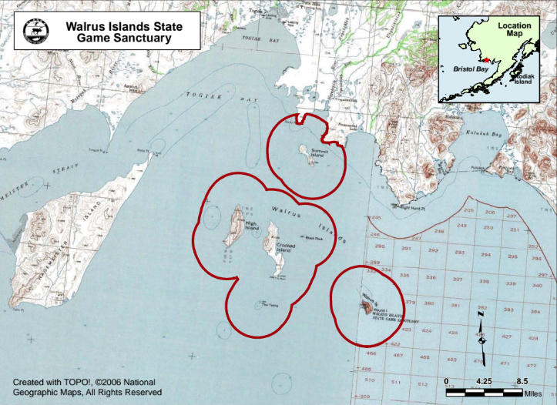
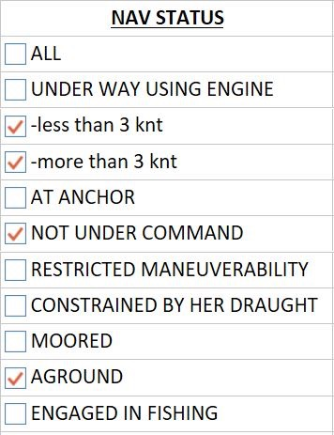
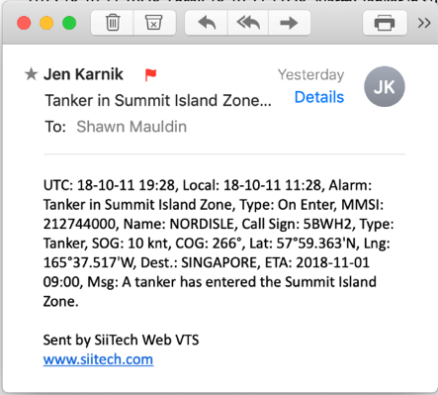
ADAC Program Year 6 Annual Meeting 14 May 2020
Arctic Vessel Monitoring Geofencing/Alert Awareness
Notifications
Zones
Alarms
In this area
Vessel’s navigation status
Results in a notification
Alarm: Tanker in Summit Island Zone.

Slide 14
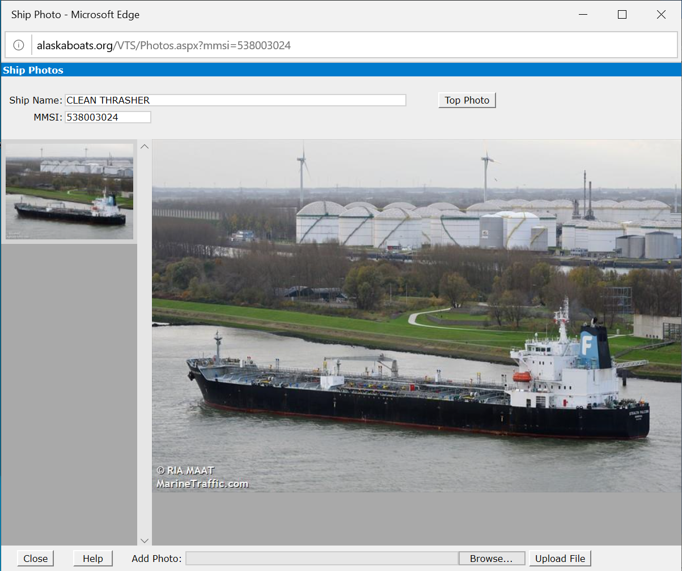
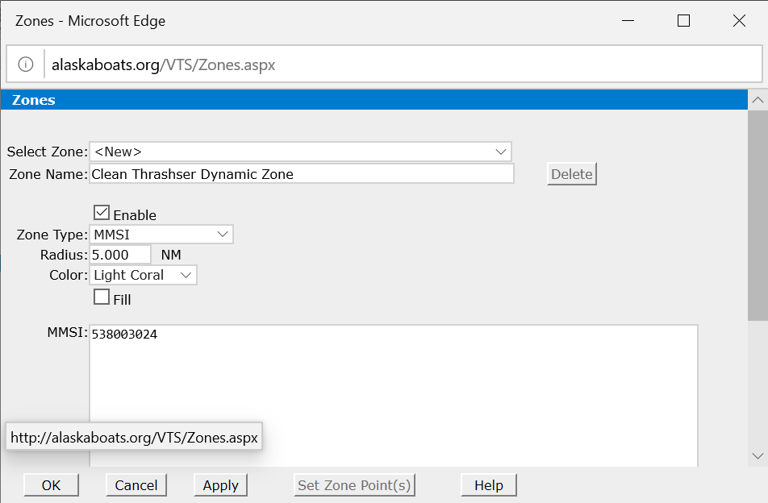
ADAC Program Year 6 Annual Meeting 14 May 2020
Dynamic Zone based on Maritime Mobile Service Identities (MMSI)

Slide 15
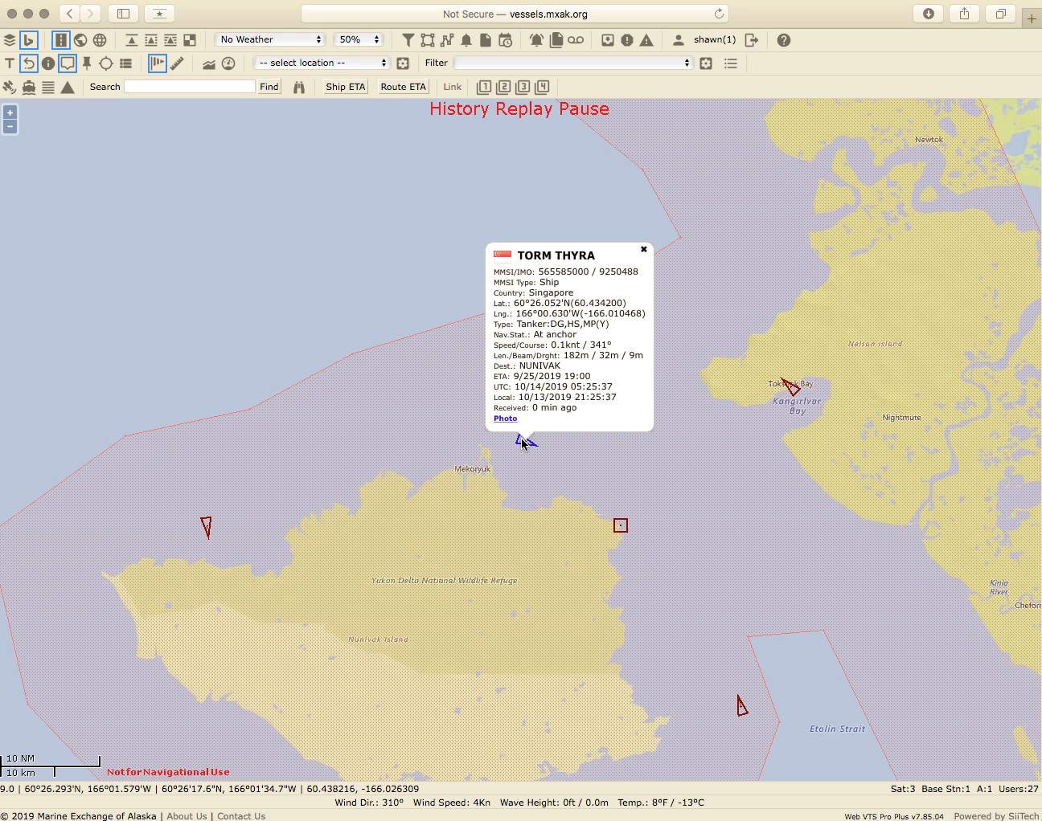
ADAC Program Year 6 Annual Meeting 14 May 2020
Dynamic Zone Creation – demonstration

Slide 16
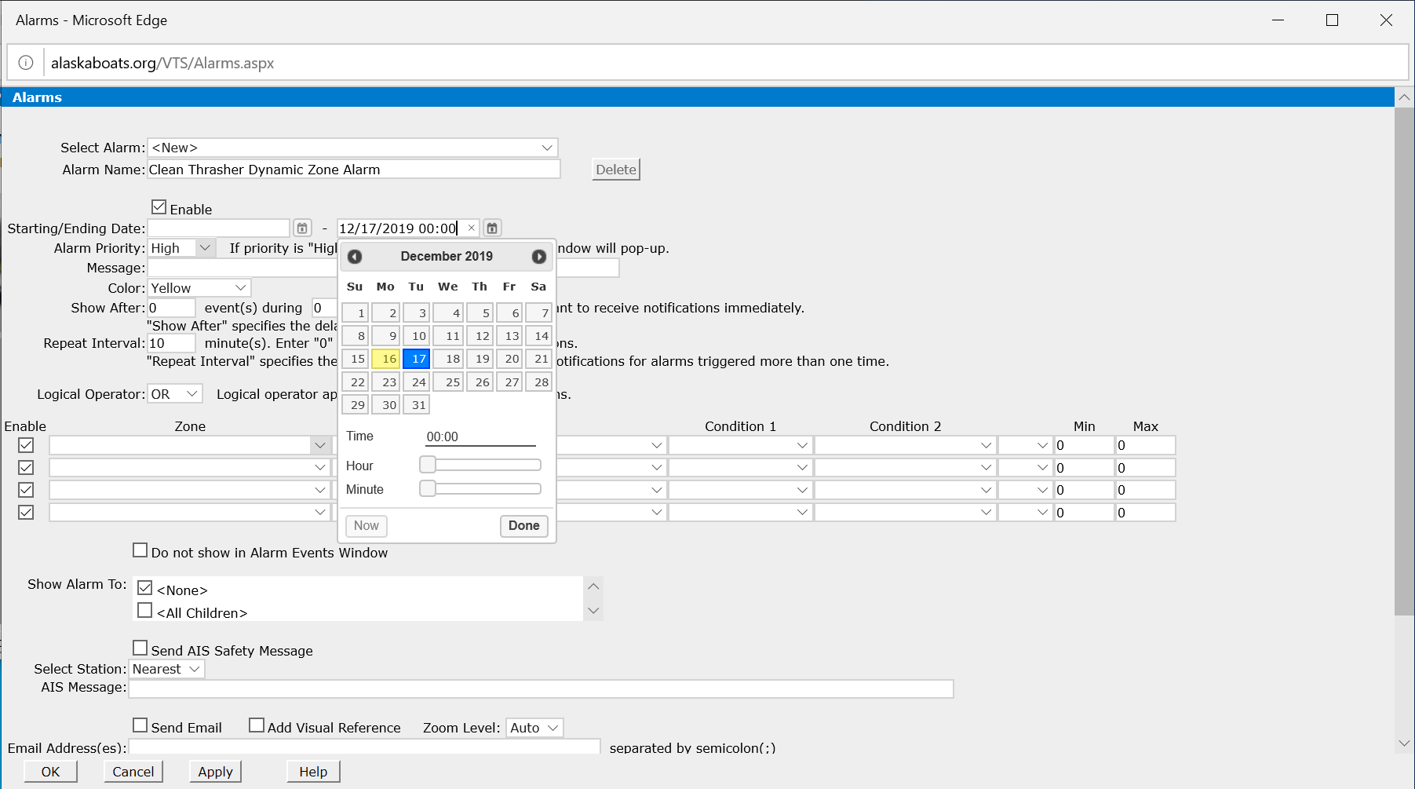
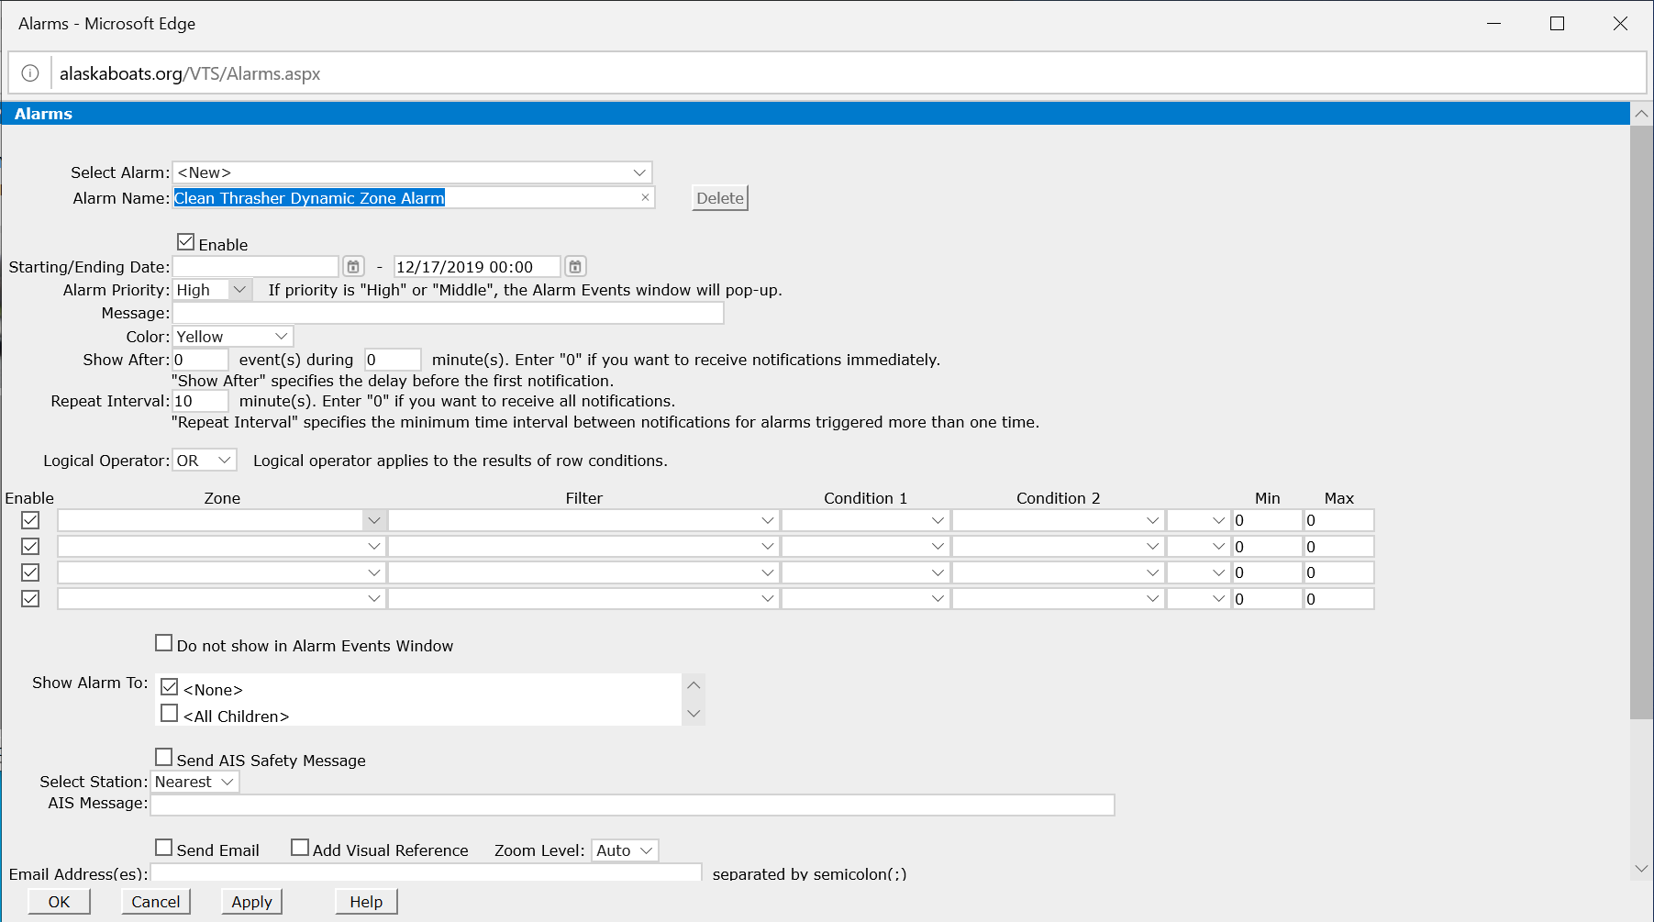
ADAC Program Year 6 Annual Meeting 14 May 2020
Creating an Alert

Slide 17
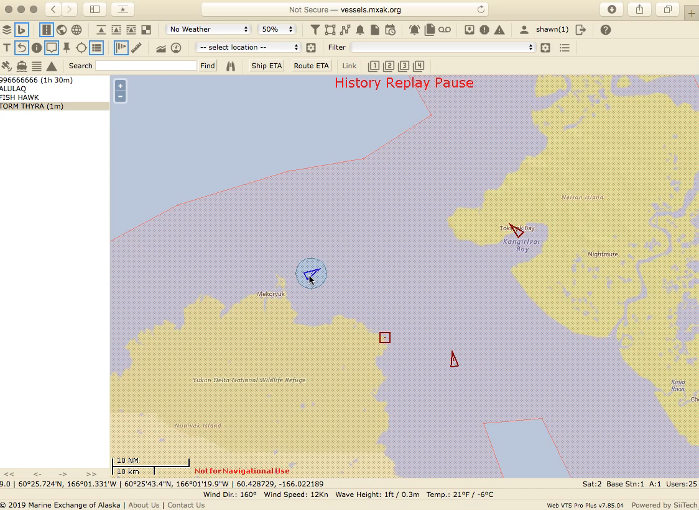
ADAC Program Year 6 Annual Meeting 14 May 2020
Alert Creation Demonstration

Slide 18
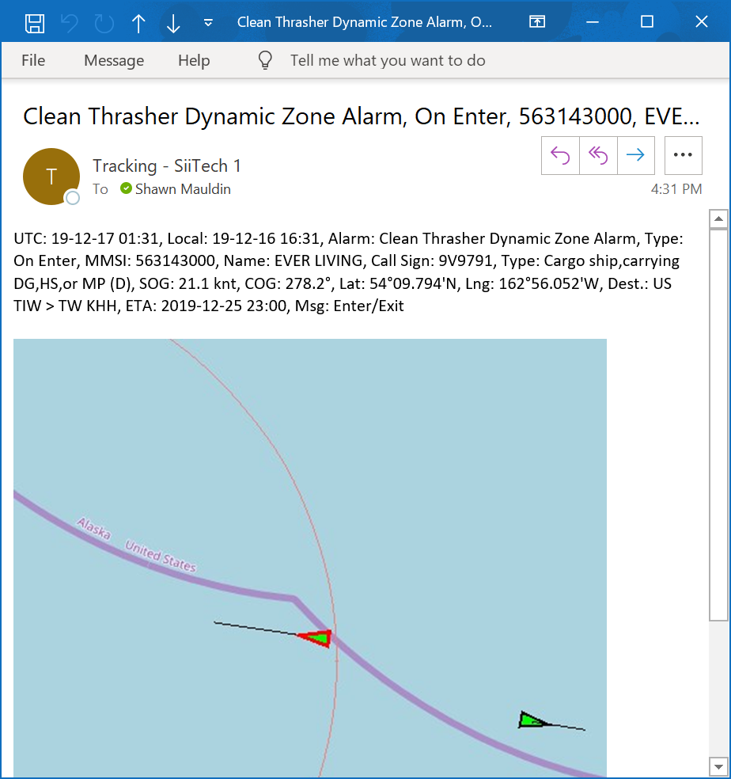
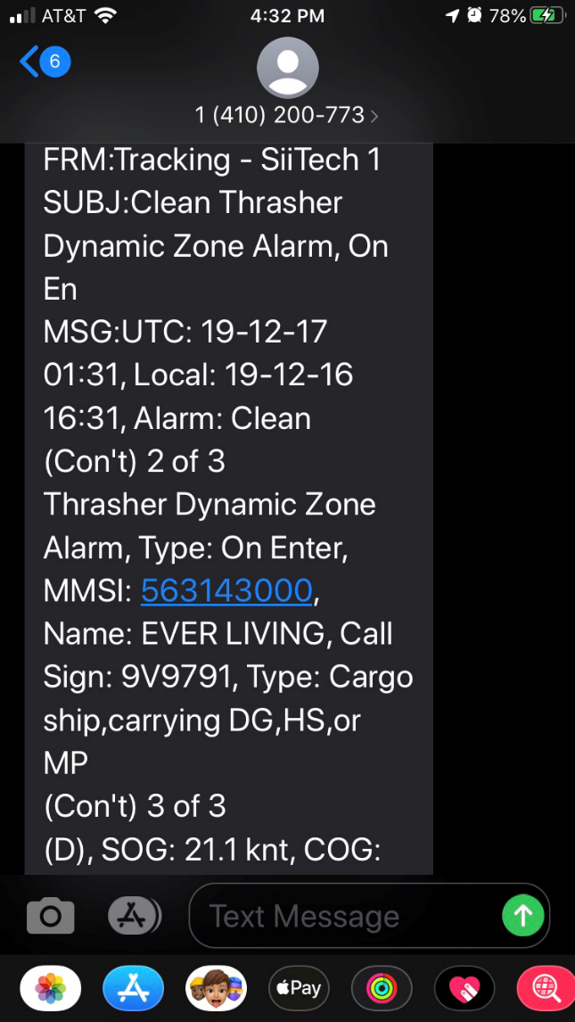
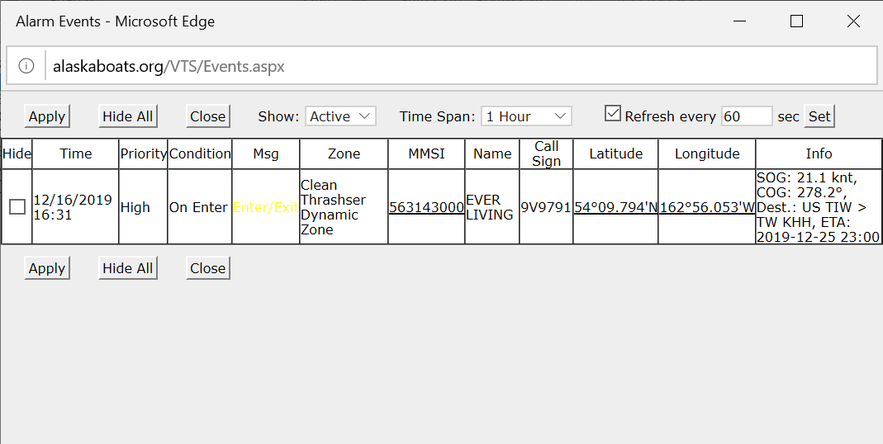
ADAC Program Year 6 Annual Meeting 14 May 2020
Alert Notification
In App
Email
Text

Slide 19
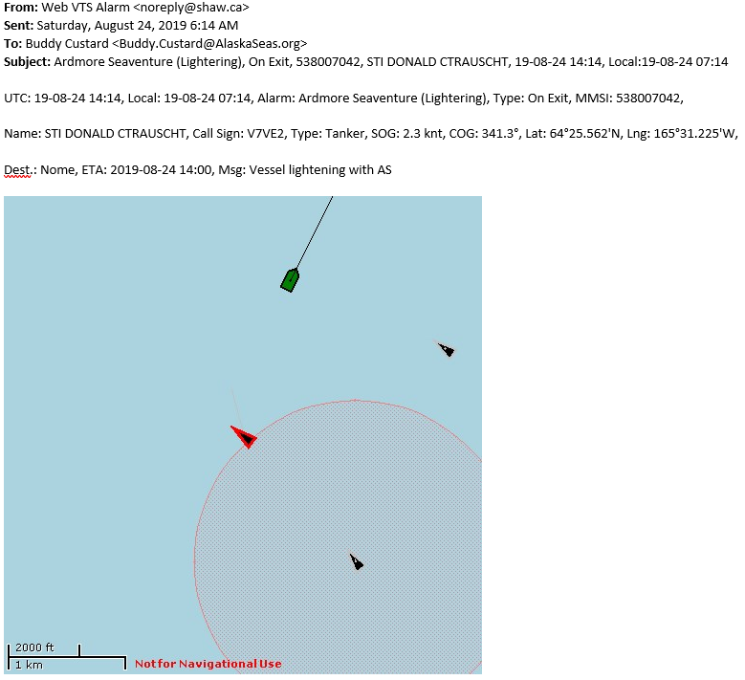
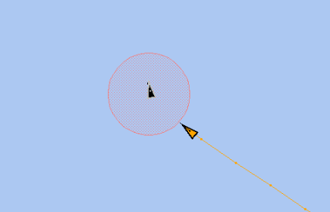
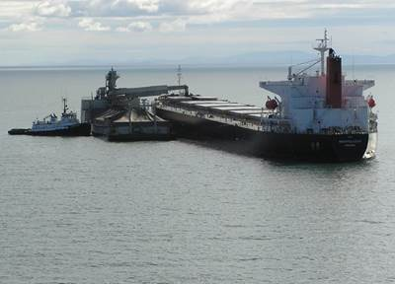
ADAC Program Year 6 Annual Meeting 14 May 2020
Dynamic Geofencing –Tanker Lightering
Notify when vessels enter within 1 nm of the vessel.
A 1 nm dynamic buffer around a tanker. As the tanker changes position, the geofence goes with it (centered on an MMSI rather than static coordinate. The orange track is a lightering tug.

Slide 20
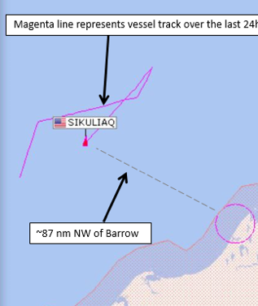
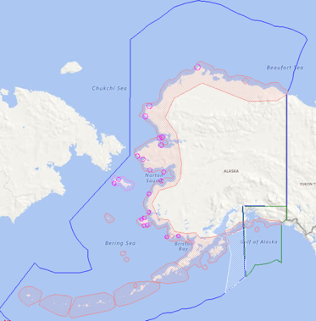

ADAC Program Year 6 Annual Meeting 14 May 2020
Vessel of Concern
Vessel has reported NOT UNDER…
UTC: 17-08-15 07:31, Local: 17-08-14 11:31, Alarm: Vessel not under command, Type: Upon Activation, MMSI: 338417000, Name: SIKULIAQ, Call Sign: WDG7520, Type: Other, SOG: .4knt, COG: 324˚, Lat: 71˚56.911’N, Lng: 160˚55.942’W, Dest.: 72 North, ETA: 2017-08-14 19:00, Msg: A vessel has reported not under command.

Slide 21
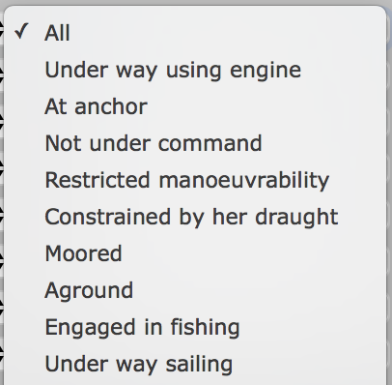

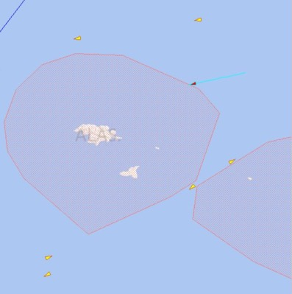
ADAC Program Year 6 Annual Meeting 14 May 2020
Vessel Entering Area to be Avoided
Vessel entering ATBA…
UTC: 18-09-13 13:07, Local 18-09-13 05:07, Alarm: Vessel entering ATBA around Attu Island, MMSI: 368044750, Name: ZIM ONTARIO, Type: Tug, SOG: 13.3 knt, COG: 250.5˚, Lat: 53°17.600’N, Lng: 174°20.028’E, Dest.: KRPUS, ETA: 18-08-09 20:18, Msg: A vessel has entered the ATBA around Attu Island.
Less than 50nm off shore

Slide 22
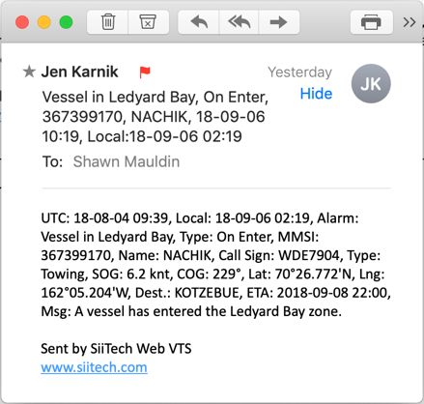
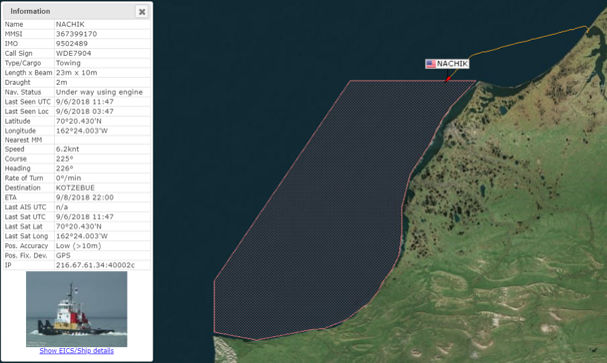
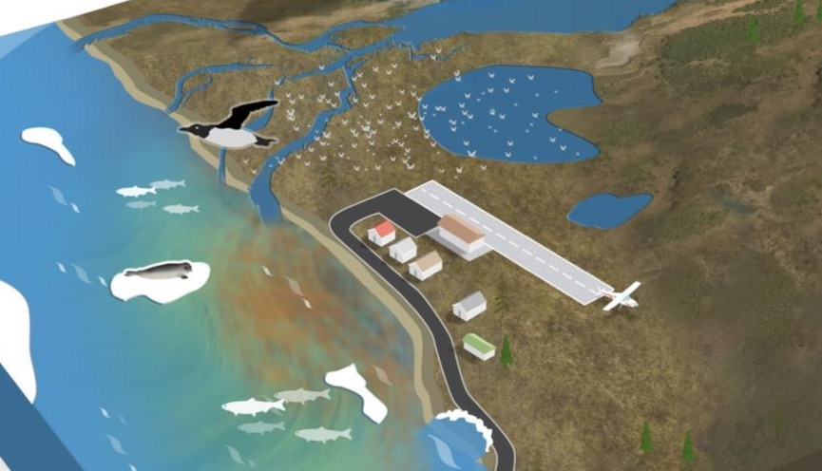


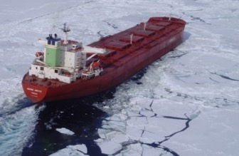
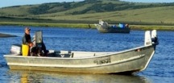
ADAC Program Year 6 Annual Meeting 14 May 2020
Avoiding Critical Habitat Areas
Marine Mammal Haulout
Critical Habitat Area
Subsistence Harvest

Slide 23







ADAC Program Year 6 Annual Meeting 14 May 2020
Wildlife Conservation Grant
The Alaska Conservation Foundation (ACF) was awarded the grant Mitigating disturbance to critical shoreline habitat for marine mammals in the rapidly changing Alaskan Arctic by the Wildlife Conservation Society (WCS) in January of 2019 as part of their climate adaptation focus area.
Grant allows for the deployment of geofencing around marine mammal haulouts through a process developed carefully and thoughtfully with the agencies, tribes, and tribal organizations that co-manage these species.
Only possible because of the research and development efforts supported by the Arctic Domain Awareness Center (ADAC) under the project: Arctic Vessel Monitoring Geofence/Alert Awareness.

Slide 24
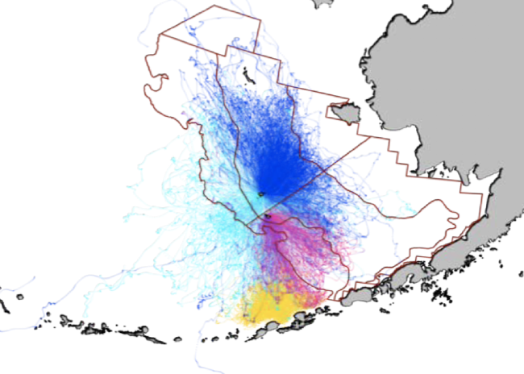
ADAC Program Year 6 Annual Meeting 14 May 2020
Geofence Example: Pribilof Islands

Slide 25
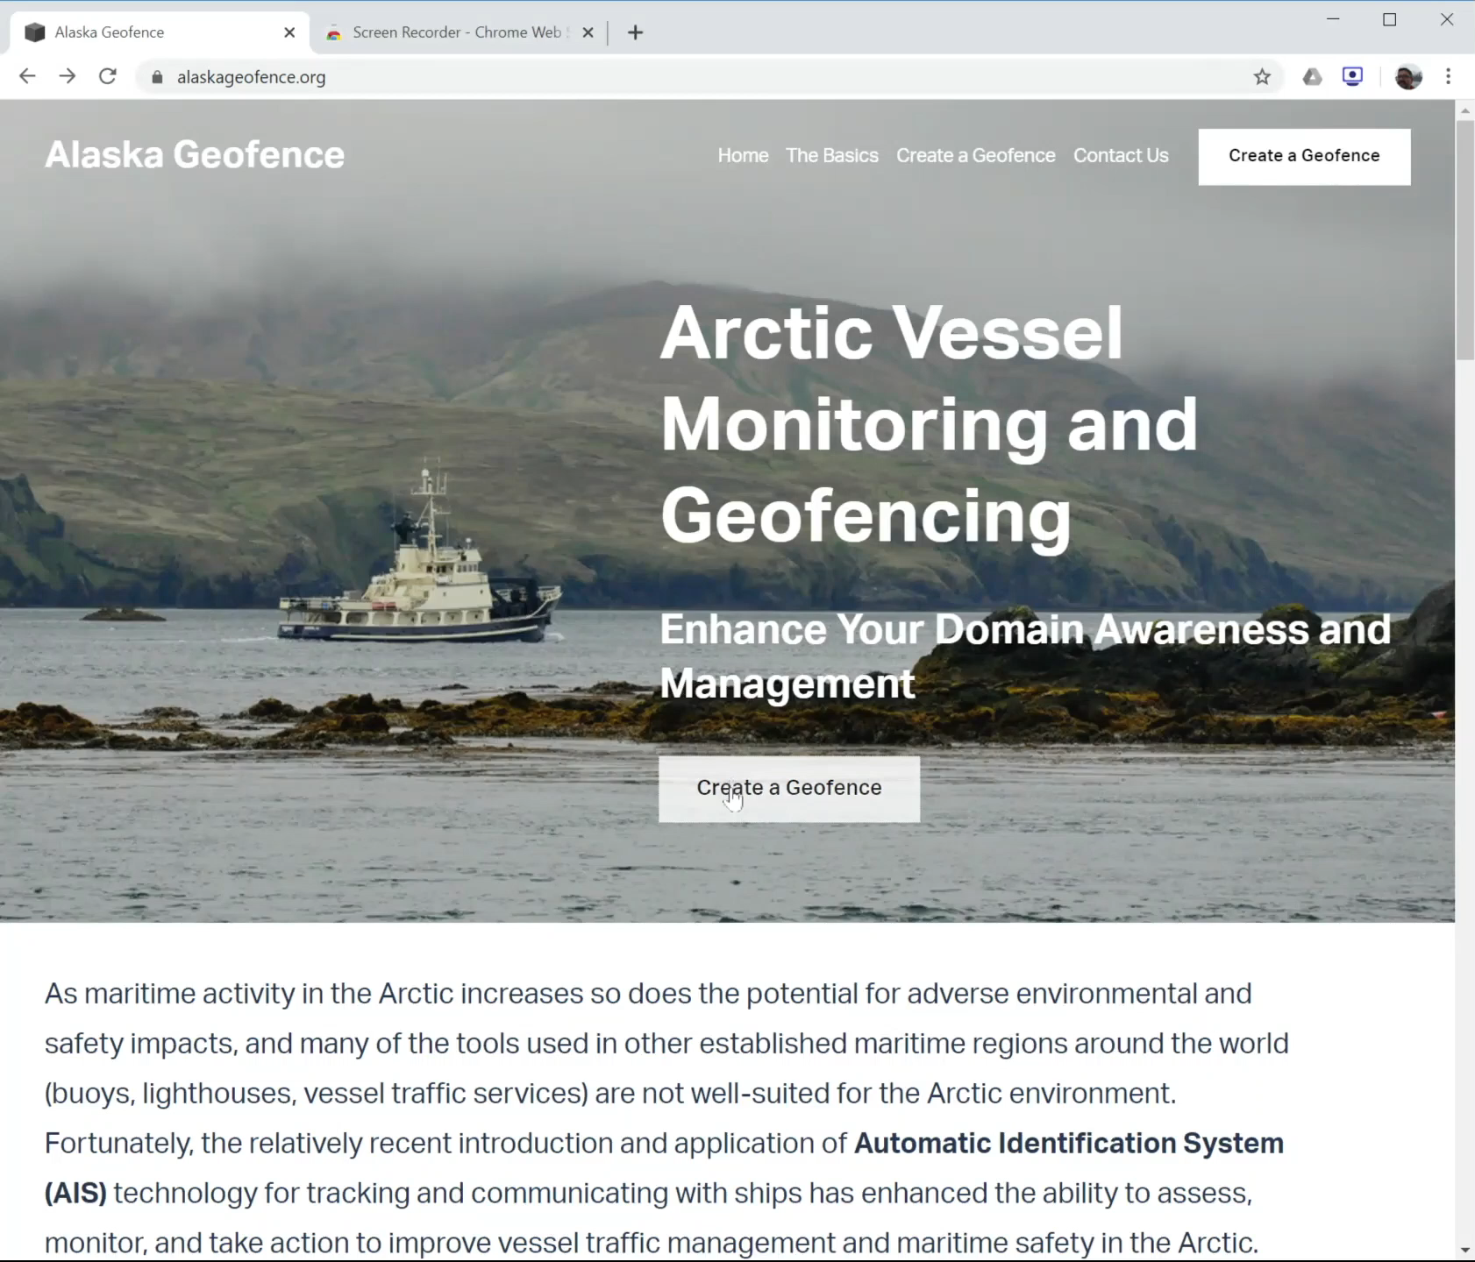
AlaskaGeofence.org
ADAC Program Year 6 Annual Meeting 14 May 2020
AlaskaGeofence.org

Slide 26
ADAC Program Year 6 Annual Meeting 14 May 2020
Test & Evaluation
Saint Paul Fur Seals critical habitat area
  six concentric rings (at 3, 10, 25, 50, 100, and 150nm) with the fur seal colony at the center.
  8 alerts – an in/out at each of the rings, an alert for vessels “within 3-10nm”, and an alert for vessels “within 3 nm”.
  Between 7/29/2019 and 12/26/2019, a total of 8,217 alerts were sent to three different email addresses (24,651 emails all told).
Dynamic Zone
  Over a dozen zones created
  Received alert notification for each (in app, email, and text)
Obtaining additional feedback from D17 Command Center
Training Sector Anchorage Command Pends

Slide 27
ADAC Program Year 6 Annual Meeting 14 May 2020
Transition Plan
Incorporated upgraded software into current PACTRACS unclassified AIS software display system for use by the Coast Guard in Alaska.
Forms the basis to integrate new research into CG1 View and HSIN common operating pictures.

Slide 28
Questions and Comments
ADAC Program Year 6 Annual Meeting 14 May 2020
Arctic Vessel Monitoring Geofencing/Alert Awareness
Buddy Custard
Alaska Maritime Prevention & Response Network
Dr. Shawn Butler
University of Alaska Anchorage
Notes:
Thank you for the gift of your time and attention.

